Slide 1
Various MongoDB operations

Slide 2
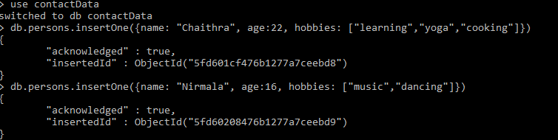
Inserting one data into the collection at a time

Slide 3
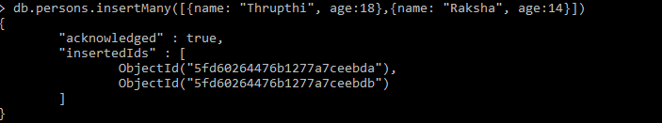
Inserting many data into the collection at a time

Slide 4
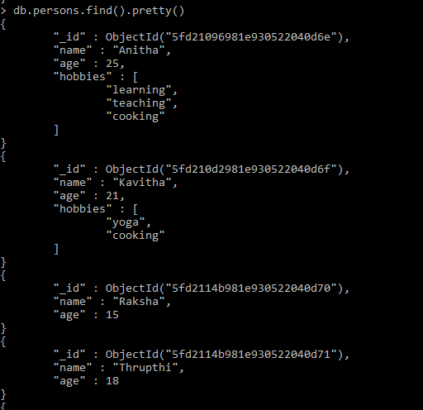
Printing all data

Slide 5

To drop a particular collection. Ex: db.persons.drop()

Slide 6
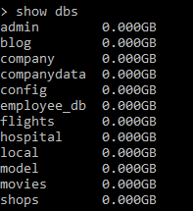
To print all databases

Slide 7

To print all the collections present in the database

Slide 8
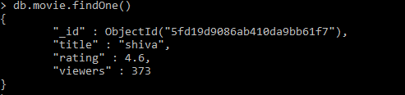
To print first data(first object)

